Slide 1
UE18CS390B – Capstone Project Phase – 2
SEMESTER - VII
END SEMESTER ASSESSMENT
Project Title : Detecting Security Vulnerabilities using Machine learning models
Project ID : PW22VJ01
Project Guide : Prof. Vinay Joshi
Project Team : Rohit Vishwakarma - PES1201800152
Sreekanth R Gunishetty - PES1201801467
Shamanth R Rao - PES1201801699
Anil M S - PES1201801866

Slide 2
Abstract & Scope
Problem Statement
Our Problem statement is finding the security vulnerabilities and cyber frauds such as fraud transactions, account takeover etc at a large scale that is humanly impossible. So Our domain for the Capstone project is Cybersecurity along with Machine learning.
A typical example of how this works is, a human needs to monitor thousands of logs per day of a website to check for anomalies. Our project tries to minimise this by machine learning all the logs and looking for anomalies and reports few suspected logs to the human for inspection. A thousand logs for inspection is reduced to few hundreds or less for inspection. This reduces response time as well as amount of logs to check.

Slide 3
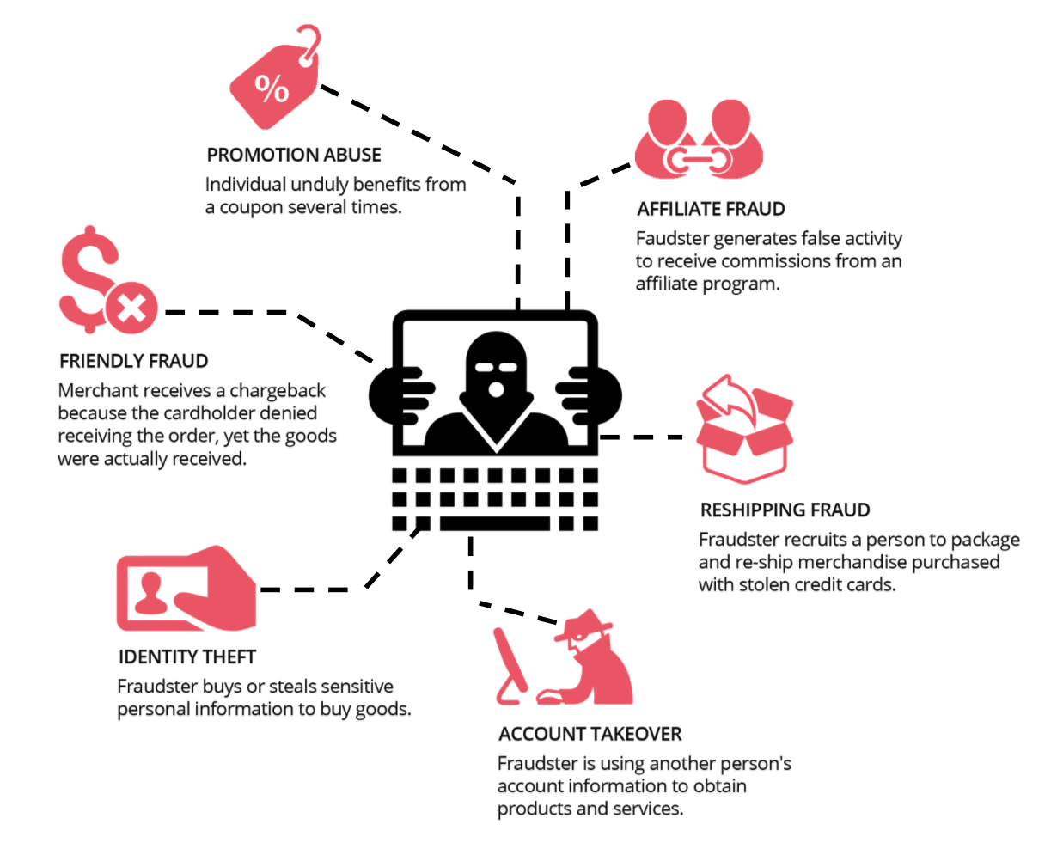


Types of Frauds to be detected
Breach in terms of Use
Self Delivery Fraud
Identity Theft

Slide 4
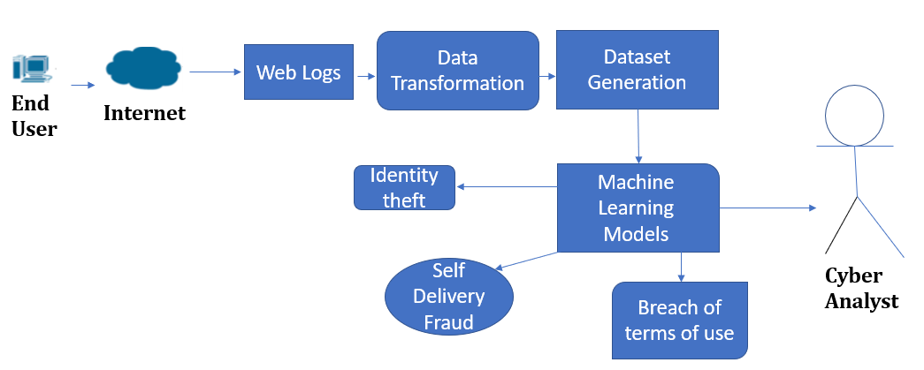
Architecture Design
The System follows an Event-driven architecture.
Structure of the model
An outside web server sends data to our model. The model consists of a powerful server that trains the data both supervised and unsupervised.
The human analyst reads through the report from the model and trains it by reporting false positives and positives.
The model can either store the data with itself or send it back to the web server for reporting. So, Our model structure is independent of the structure of the web server model.
Web server asynchronously sends the data to our machine learning model and our model processes and reports the anomalies to the cyber analyst.

Slide 5
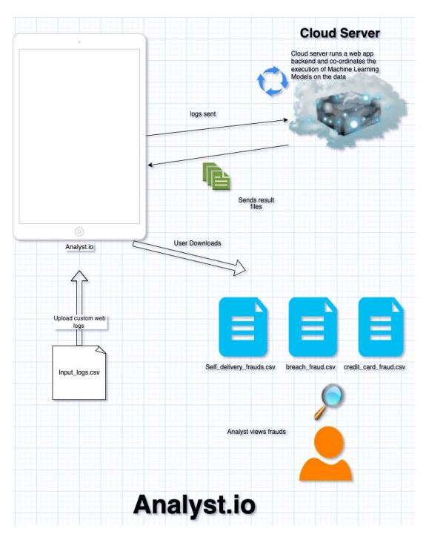
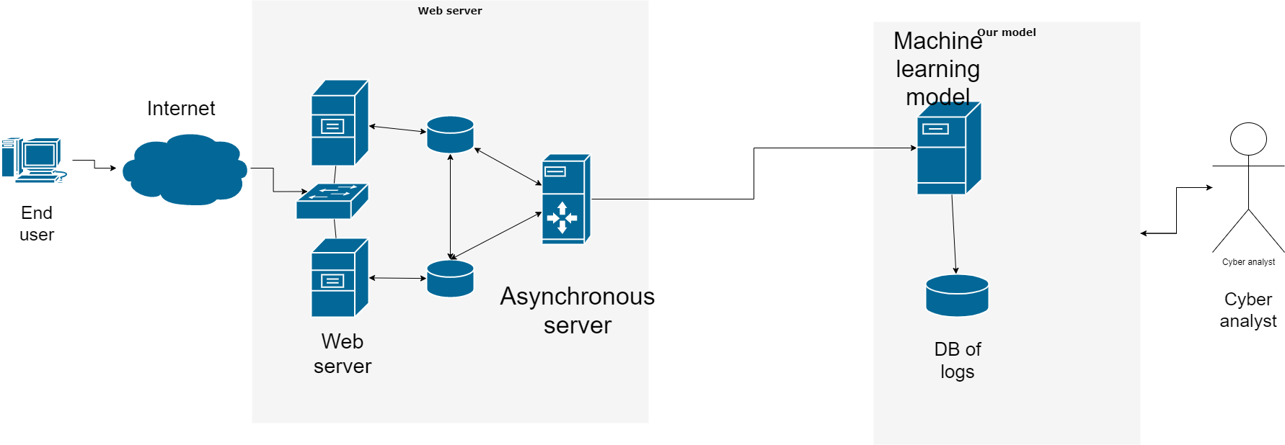
High Level and System Architecture Design
High Level Design View
System Architecture

Slide 6

Project Demo and Code Walkthrough

Slide 7
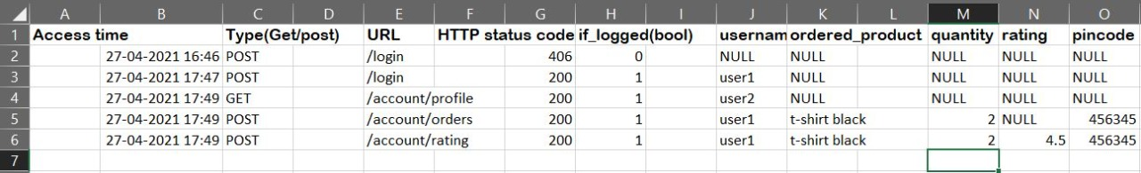
Data Generation & E-commerce Website
Format of logs:
Login Page
[ client_ip, Method = [Get, Post], httpStatusCode, relative_path of the website page, name_of_page ,IsLoggedIn, user_id, email used for logging]
Register Page
[client_ip, Method = [Get, Post], httpStatusCode, relative_path of the website page,name_of_page, IsLoggedIn , user_id, email used for logging]
Cart Page
[client_ip, Method=[GET, POST], httpStatusCode ,relative path of the website page, ifLoggedIn, userId, email, credit_card/debit card Number, productId, ratingGiven, zip code of the client ]
Update Profile Page
[client_ip, Method = [Get, Post], httpStatusCode, relative_path of the website page,name_of_page, IsLoggedIn , user_id, email used for logging]
Dataset Format:

Slide 8



Methodology / Approach
Machine Learning in Cybersecurity Domain

Slide 9
Modules and Implementation Details
Colab Links:
Breach in terms of use
https://colab.research.google.com/drive/1tGXZ_cpsN1lQZr6nDDx5tmZHsKt4uVgo
Self Delivery Fraud
https://colab.research.google.com/drive/1nRv-nc6XSrEjrtelcIzjXJNteNX-Ylu-
Credit Card Fraud Detection
https://colab.research.google.com/drive/1tF4UwyH38m4weKay_WTLG5GG51eiz2tG

Slide 10
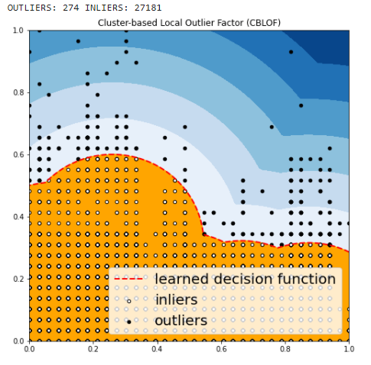
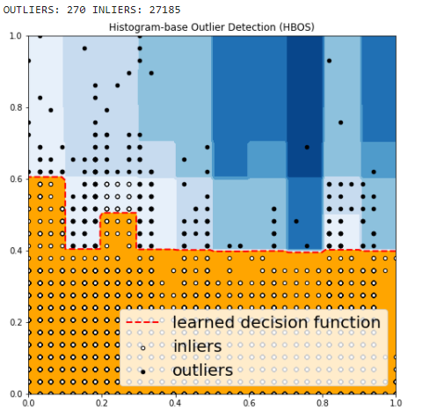
Results and Discussion
Breach in terms of use
Cluster Based Local Outlier Factor
Histogram Based Outlier Detection

Slide 11
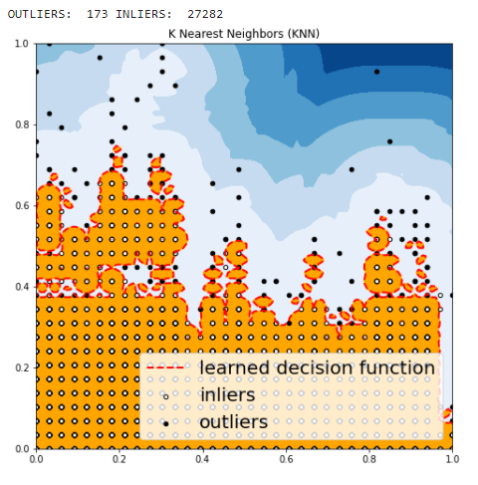
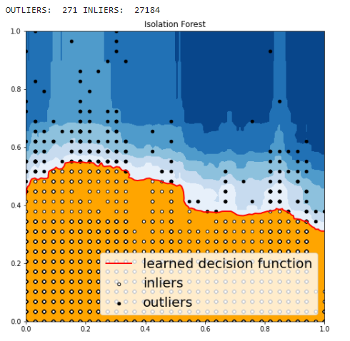
Results and Discussion
Breach in terms of use
K Nearest Neighbors
Isolation Forest

Slide 12
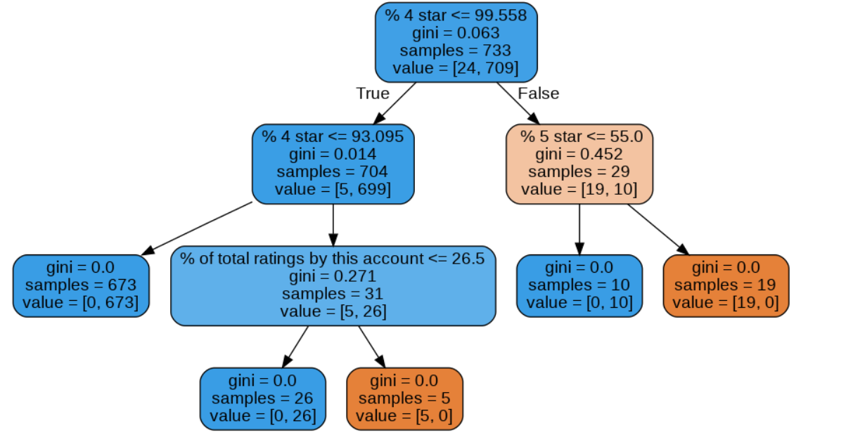
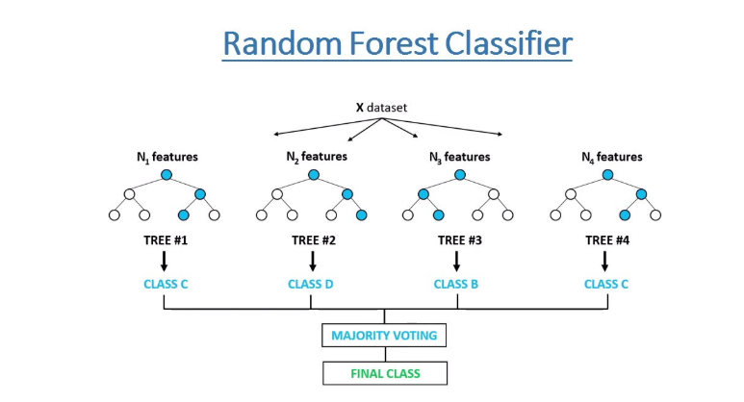
Results and Discussion
Self Delivery Fraud Detection
Random Forest
Decision Tree

Slide 13
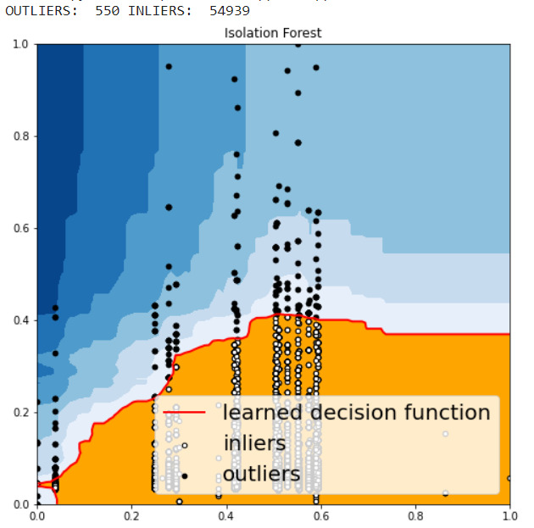
Results and Discussion
Credit Card Fraud Detection

Slide 14
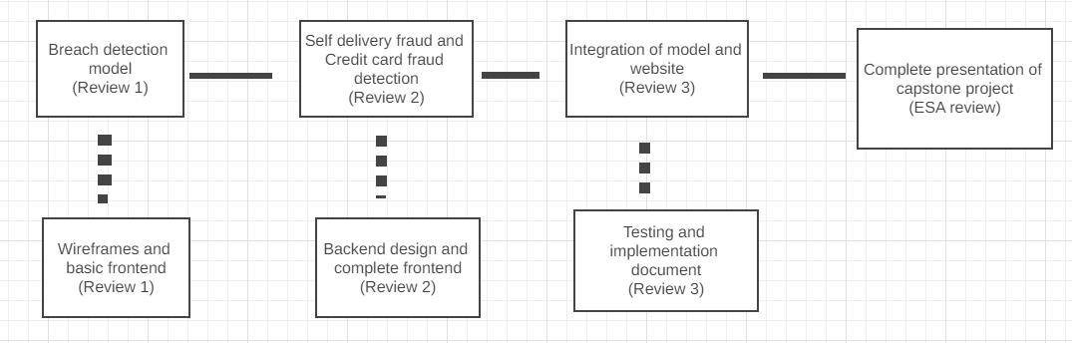
Schedule & Gantt chart

Slide 15
Documentations
Team Details
Low Level Design Document
Plagiarism Report
Project Poster
Final ESA Presentation
Project Report
Project Code and Executables
Weekly Status Report
Project Demo
https://drive.google.com/drive/folders/1Hg4Uwqnfig91QG3UD1gCjDuNS8Y6Rj20

Slide 16
Team Roles and Responsibilities
Rohit Vishwakarma PES1201800152 | User Interface and Backend Design, Building an e-commerce website for Data Generation, Data Organising and Maintenance, Integration of Modules, Development and deployment of e-commerce site for dataset generation.
Sreekanth R Gunishetty PES1201801467 | Data Pre-Processing for Breach Fraud Detection, Selection of ML Models and their implementations for all fraud detection mechanisms, Project Documentations and Finalisation of each module in the Project.
Shamanth R Rao PES1201801699 | Pitching an Idea of Project, Writing an appropriate scripts for Data Generation, Requirement Analysis, Research work and Selection of types of frauds to be dealt, Data Pre-processing for all Fraud Detection modules
Anil M S PES1201801866 | Wireframes for Website Pages, Help in the integration of the website and models, Poster Design and IEEE Paper Documentation, database design of e-commerce in postgres and also upgrading Sqlite DB.

Slide 17
Conclusion and Future work
The Project uses data analysis such as outlier detection and machine learning techniques to detect and analyse a large dataset of logs. We have implemented three major models to detect those frauds :-
The First model can be implemented by outlier detection of user activities over a period of time. The model thus trained by this is again trained when it gets a fresh set of data from the website on the next day or another week.
The Second model detects merchants ordering for themselves and giving high ratings. The plan to detect this is by looking at the deliveries and rating for the different products from the same merchant. All high ratings and same delivery locations raise suspicion.
The Third model detects card frauds where stolen cards are used for an unusually high number of purchases.
Future Works
The Website can facilitate to take an input as customised logs and give an output of various detected fraud transactions in the form of csv
Increase the accuracy of three models of Breach Fraud Detection, Self Delivery Fraud and Credit Card Fraud
We can add more features and detection mechanisms in Our Analyst.io website

Slide 18
References
Kou, Yufeng, et al. "Survey of fraud detection techniques." IEEE International Conference on Networking, Sensing and Control, 2004. Vol. 2. IEEE, 2004.
Tripathi, Diwakar, Bhawana Nigam, and Damodar Reddy Edla. "A novel web fraud detection technique using association rule mining." Procedia computer science 115 (2017): 274-281.
Campus, Kattankulathur. "Credit card fraud detection using machine learning models and collating machine learning models." International Journal of Pure and Applied Mathematics 118.20 (2018): 825-838.
Breier, Jakub, and Jana Branišová. "Anomaly detection from log files using data mining techniques." Information Science and Applications. Springer, Berlin, Heidelberg, 2015. 449-457.
Maniraj, S., et al. "Credit card fraud detection using machine learning and data science." International Journal of Engineering Research and 8.09 (2019).

Slide 19
Thank You

